Slide 1
Aanbevolen literatuur
Dus niet verplicht!

Slide 2
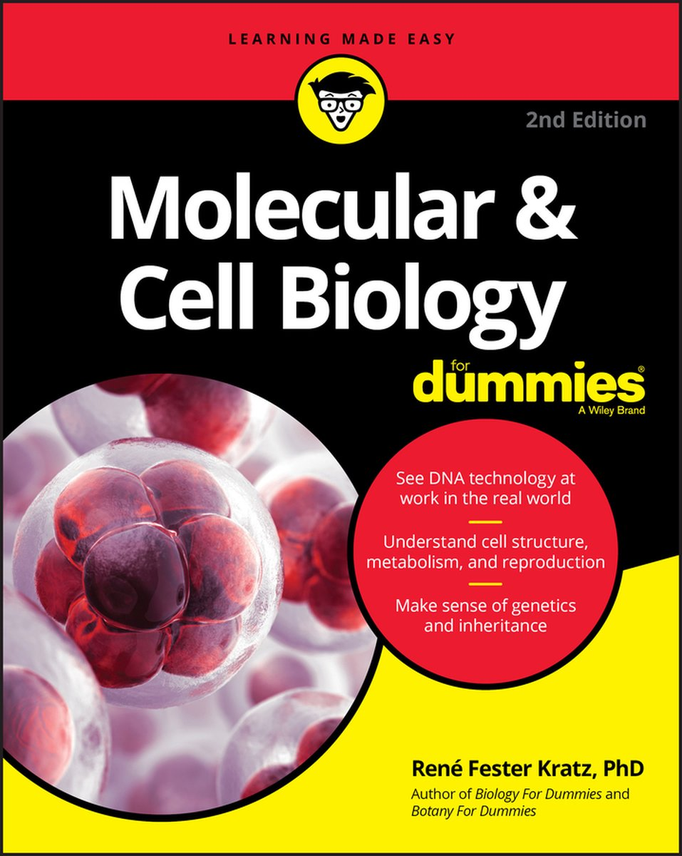
Molecular and cell biology for dummies
Rene Fester Kratz
Engels
Paperback
9781119620402
2020 (2nd edition)

Slide 3

De bouwstenen van het leven
Authors J.A.M.M. Prinsen and F.R. van der Leij
Published: 2015 Pages: 476
ISBN: 978-90-8686-270-2
=> nederlands

Slide 4

KAAS EN DE EVOLUTIETHEORIE
ISBN: 9789052406008
Auteur: B. Haring
Uitgever: VBK - Houtekiet

Slide 5

Fysiologie van de voeding
auteur: | Hekkens, W.T.J.M.; Wijn, J. F. De
Mediatype: | Boek
Bindwijze: | Paperback
Taal: | Nederlands
Druk: | 2
Aantal pagina's: | 519
Uitgever: | Bohn Stafleu van Loghum
NUR: | Dieet- en voedingsleer
Afmetingen: | 210 x 132
Gewicht: | 601 gr
ISBN/ISBN13: | 9789031310098

Slide 6
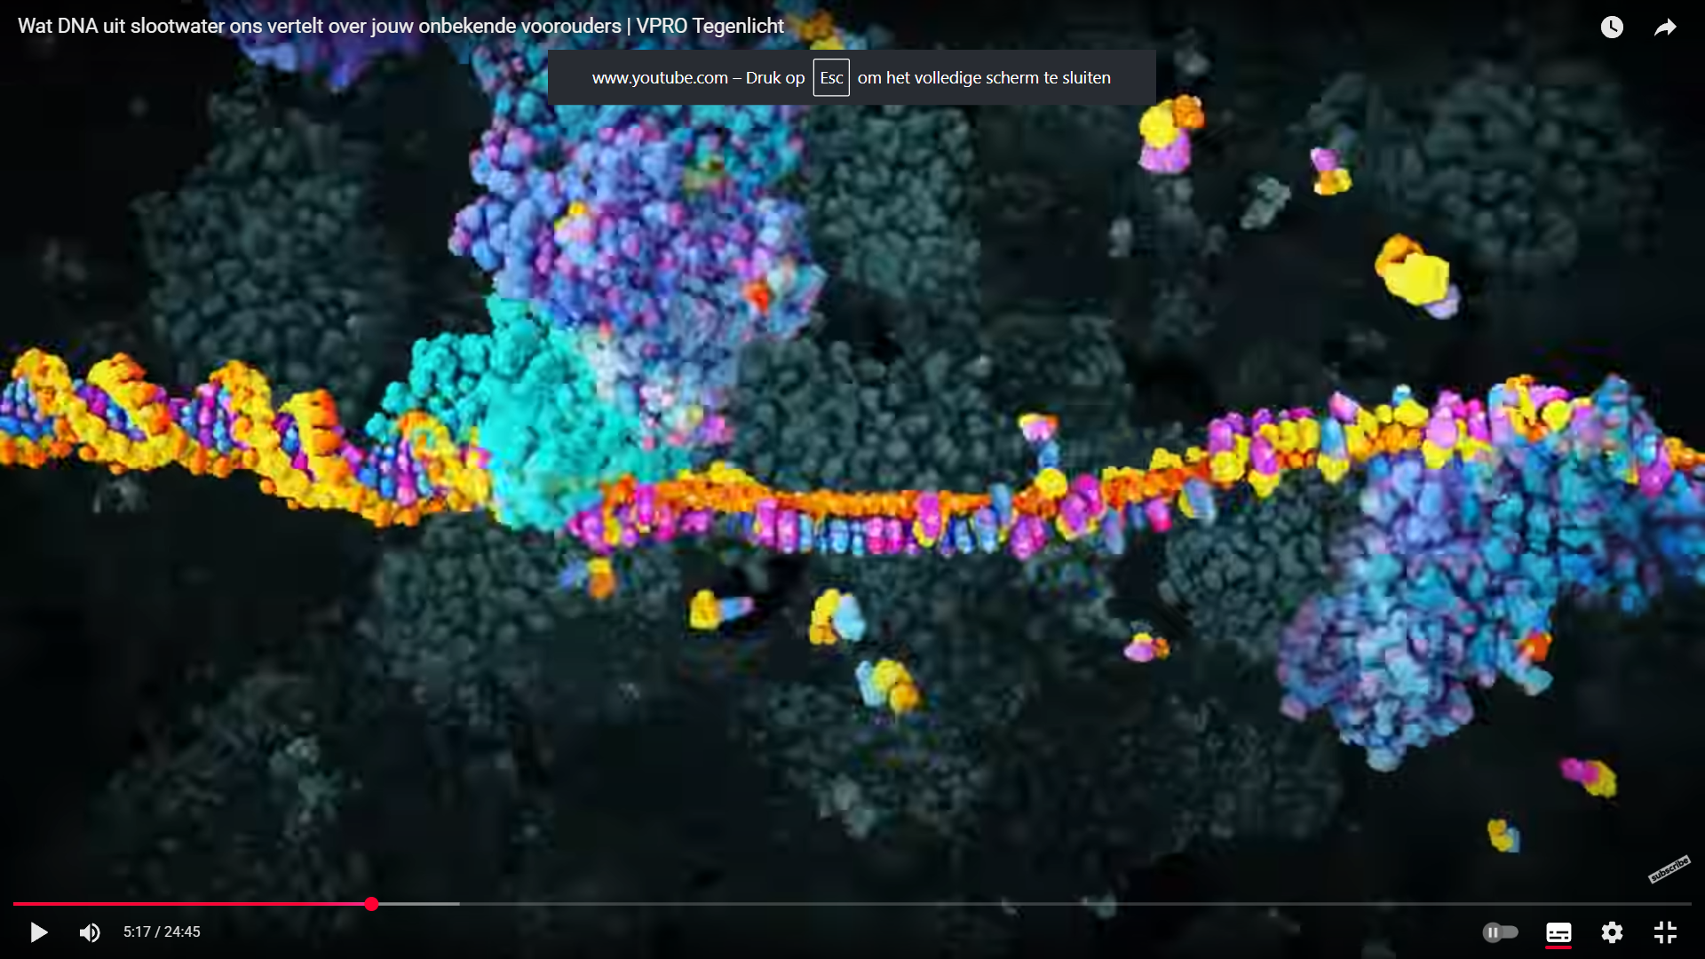

Video’s, podcasts, websites..
https://youtu.be/rUvnoqH-sJI
https://youtu.be/7Hk9jct2ozY?list=PLD0444BD542B4D7D9
https://www.nrc.nl/podcast/onbehaarde-apen/
https://youtu.be/AwlBQ-qCEtg
https://www.biomaatschappij.nl/product/synthetische-biologie/

Slide 7
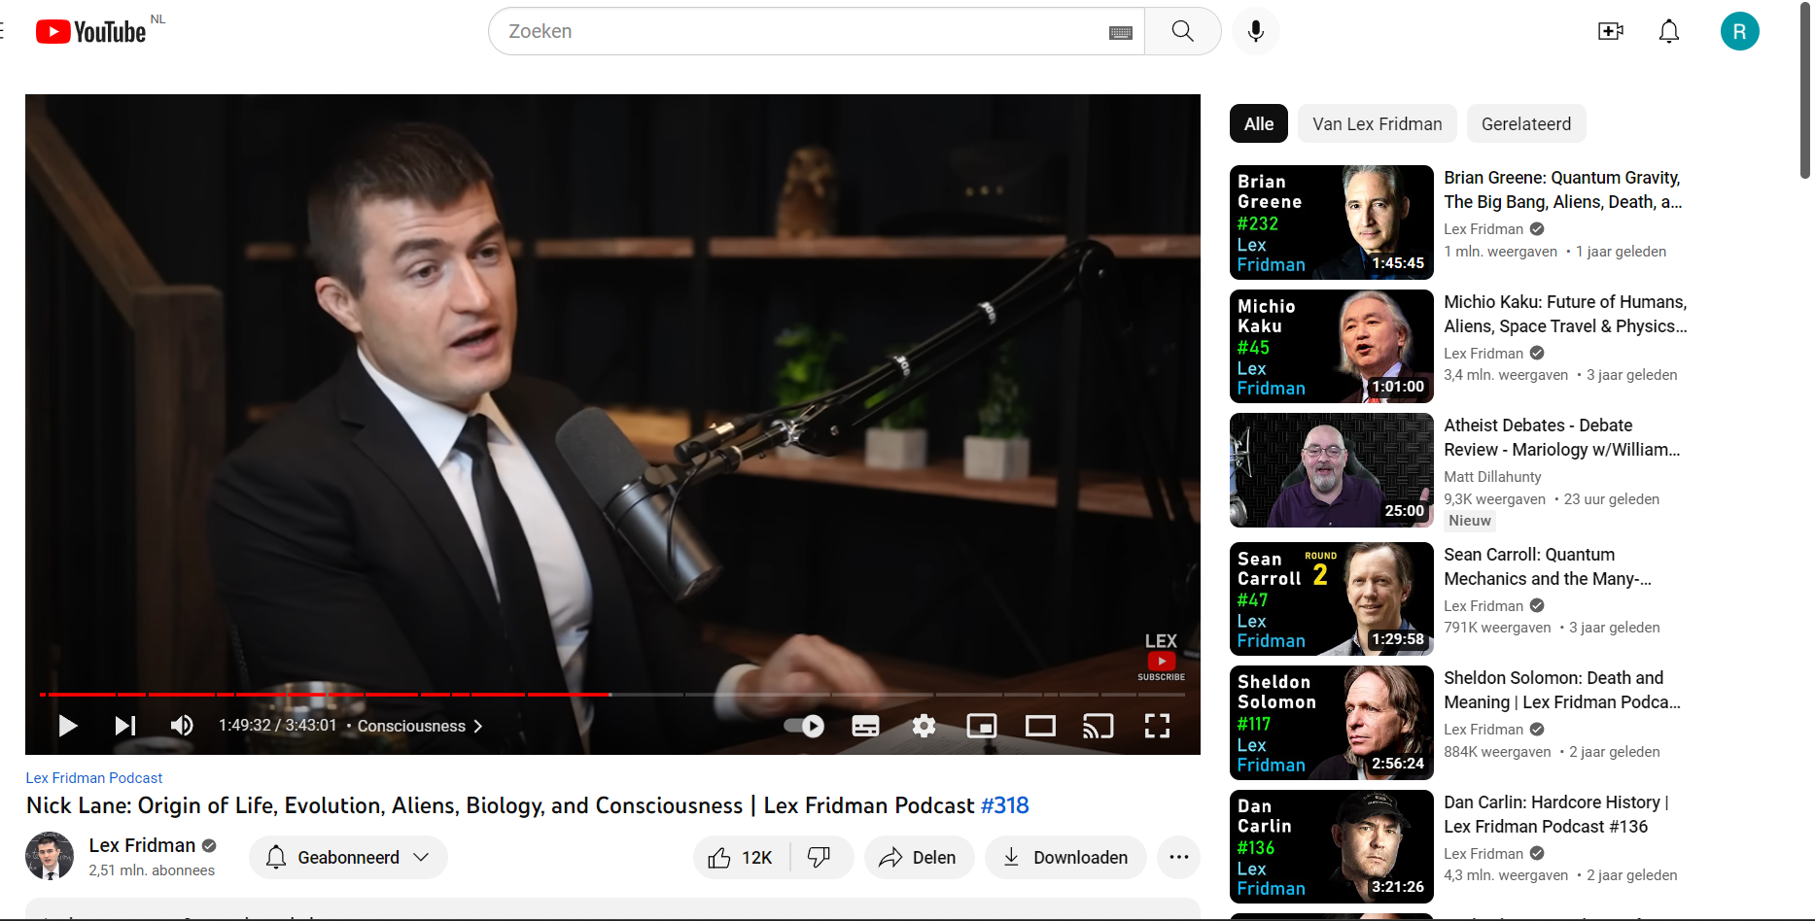
Lex Fridman podcast
https://youtu.be/tOtdJcco3YM

Slide 8


Nick Lane
Mitochondria and the meaning of life
=> 2005. Oxford University Press.: New York, New York, USA. 368p. ISBN: 0-192-80481-2
The vital question
=> 9781781250372, 2016

Slide 9

How to Create a Mind
Author Ray Kurzweil
Country United States
Language English
Publisher Viking Penguin
Publication date
2012
Pages 352
ISBN 978-0670025299

Slide 10

Biology
Publisher: Benjamin Cummings, 2004
ISBN 10: 080537146X
ISBN 13: 9780805371468

Slide 11

Religion explained.
The Evolutionary Origins of Religious Thought
Author | Pascal Boyer
Language | English
Subject | Religion
Genre | Science
Publisher | Basic Books
Publication date | 2001
ISBN | 0-465-00696-5
OCLC | 50628396

Slide 12

A short history of nearly everything
Author | Bill Bryson
Language | English
Genre | Non-fiction
Publisher | Black Swan (UK) Broadway Books (US)
Publication date | 2003
Media type | Print (Hardcover, Paperback, E-Book)
ISBN | 0-7679-0817-1

Slide 13

The quantum universe
Author | Brian Cox, Jeff Forshaw
Country | United States
Language | English
Subject | Physics, quantum mechanics
Genre | Non-fiction
Publisher | Allen Lane
Publication date | 29 October 2011
Media type | Print (hardcover)
Pages | 272 pp.
ISBN | 978-1846144325

Slide 14


Harari
Sapiens
=> Engels, Paperback, 9780099590088, 2015
Homo Deus
=> Engels, Paperback, 9781784703936, 2017

Slide 15

Life-changing biology
Genetically engineered genomes will disrupt the bioeconomy and rewrite human nature—are we ready?

